Slide 1
Primary PE
&
Sport Premium
Thursday 22nd October 2020
Tracy Raynor
School Sport Project Officer
Tees Valley Sport
t.raynor@tees.ac.uk
www.teesvalleysport.co.uk
@teesvalleysport

Slide 2
Aims:
Conditions of the sport premium grant
How to plan and report on your use of funding
Sustainable measures for spending your funding

Slide 3
47% of children were active for the recommended 60 minutes per day pre Covid, this dropped to 19% during lockdown.
9% of parents reported children doing no physical activity at all.
Sport England July 2020
73% returning to school with low physical fitness
49% mental wellbeing issues including anxiety
YST September 2020

Slide 4
How to use the PE and sport premium
Schools can use the premium to secure improvements in the following indicators:
The engagement of all pupils in regular physical activity – the Chief Medical Officer guidelines recommend that all children and young people aged 5 to 18 engage in at least 60 minutes of physical activity a day, of which 30 minutes should be in school
The profile of PE and sport is raised across the school as a tool for whole-school improvement
Increased confidence, knowledge and skills of all staff in teaching PE and sport
Broader experience of a range of sports and activities offered to all pupils
Increased participation in competitive sport

Slide 5
How to use the PE and sport premium
Schools must use the funding to make additional and sustainable improvements to the quality of physical education (PE), physical activity and sport you offer.
This means that you should use the premium to:
develop or add to the PE, physical activity and sport activities that your school already offers
build capacity and capability within the school to ensure that improvements made now will benefit pupils joining the school in future years
Ofsted inspections
Ofsted assesses how primary schools use the primary PE and sport premium. They measure its impact on pupil outcomes, and how effectively governors hold school leaders to account for this.
This will be reported under the ‘effectiveness of leadership and management’ section of the framework

Slide 6
What your funding should not be used for
You should not use your funding to:
Employ coaches or specialist teachers to cover planning preparation and assessment (PPA) arrangements – these should come out of your core staffing budgets
Teach the minimum requirements of the national curriculum – with the exception of top-up swimming lessons after pupils’ completion of core lessons (or, in the case of academies and free schools, to teach your existing PE curriculum)
Fund capital expenditure
“The DfE does not set the capitalisation policy for each school. School business managers, school accountants and their auditors are best placed to advise on school’s agreed capitalisation policy. We encourage schools to consult with their school business manager, accountant or auditor to determine which items would be considered capital expenditure.”

Slide 7
Online reporting
You must publish details of how you spend your PE and sport premium funding by the end of the summer term – Date TBC
Online reporting must include:
The amount of premium received
A full breakdown of how it has been spent
The impact the school has seen on pupils’ PE, physical activity, sport participation and attainment
How the improvements will be sustainable in the future
You are also required to publish the percentage of pupils within your year 6 cohort in the 2020 to 2021 academic year who met the national curriculum requirement to:
Swim competently, confidently and proficiently over a distance of at least 25 metres
Use a range of strokes effectively
Perform safe self-rescue in different water-based situations
Attainment data for year 6 pupils should be provided from their most recent swimming lessons. This may be data from years 3, 4, 5 or 6, depending on the swimming programme at your school.

Slide 8
Must include:
The amount of premium received
A full breakdown of how it has been spent
The impact the school has seen on pupils’ PE, physical activity, sport participation and attainment
How the improvements will be sustainable in the future
How many pupils within their Year 6 cohort are meeting the national curriculum requirement for swimming

Slide 10
Reflection
What key achievements are you proud of from the previous academic year?

Slide 11
Updated government guidance states:
“Where schools are carrying forward under-spends,
their published online report should set out the amount being
carried forward and give brief reasons for this underspend.
Any under-spends carried forward will need to be spent in full by
March 31, 2021 and schools should factor this into spending plans
for their 2020 to 2021 PE and Sport Premium allocation.” (DfE, 2020)

Slide 14
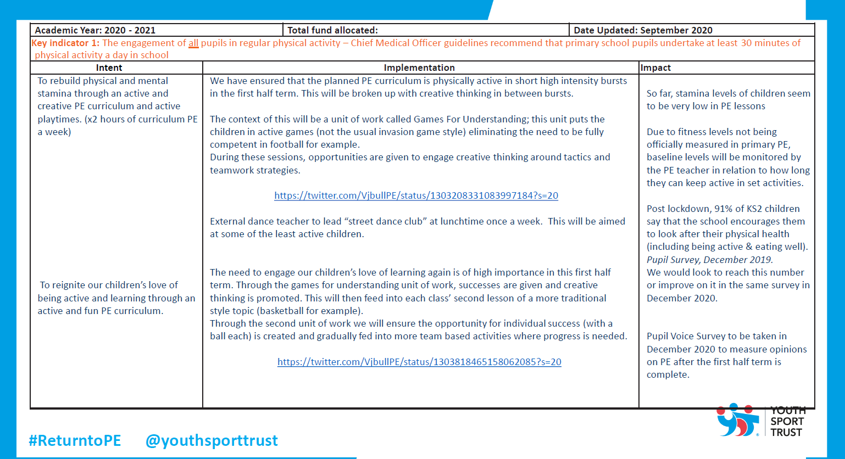

Slide 15
Key Indicator 1
The engagement of all pupils in regular physical activity – the Chief Medical Officer guidelines recommend that all children and young people aged 5 to 18 engage in at least 60 minutes of physical activity a day, of which 30 minutes should be in school

Slide 16
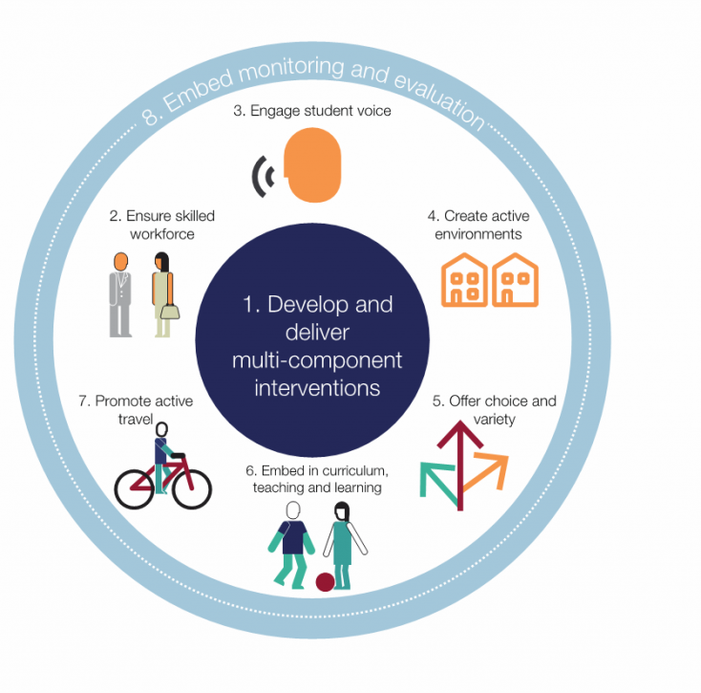
‘What works in schools and colleges to increase physical activity’
Public Health

Slide 17
Key Indicator 2
the profile of PE and sport is raised across the school as a tool for whole-school improvement
Behaviour
Attendance
Targeted intervention
Active Learning
Supporting your School Improvement Plan
Teaching life skills explicitly through PE & Sport

Slide 18
PE can have a leading role in the physical, social, emotional and cognitive wellbeing of pupils

Slide 20
Reflection
If the funding ceased how would it affect the provision for children and young people?

Slide 21
Key Indicator 3
Increased confidence, knowledge and skills of all staff in teaching PE and sport
Upskill your staff!
CPD – in house or externally
Team Teaching
Observations
Schemes of Work
Swimming
Are you sustainable?

Slide 22
Key Indicator 3
Increased confidence, knowledge and skills of all staff in teaching PE and sport
Are you sustainable?
Workforce
Key Indicator 4
Broader experience of a range of sports and activities offered to all pupils

Slide 23
Key Indicator 4
Broader experience of a range of sports and activities offered to all pupils
New activities - exit routes
Themed days
Active focus weeks
Which groups of children?
Targeted approach

Slide 24
Key Indicator 5
Increased participation in competitive sport
Mission & Vision
Competition Formats
Motivation
Competence
Confidence

Slide 25
Looking Ahead…
Sustainability
TOP TIPS :
Look for CPD opportunities linked to Physical Education delivery, whole school physically active learning strategies or outdoor learning initiatives.
Invest in CPD that aims to address staff motivations and relationships with physical activity rather than simply upskilling staff in traditional sports.

Slide 26
Whole School Improvement
TOP TIPS :
Look at your whole school improvement plan to identify any areas where sporting activities or physical activity can positively impact on targeted pupils or outcomes such as reading, writing, behaviour or attendance.
Embed successful physically active learning approaches such as Active Maths, Active Phonics or Cross Curricular Orienteering.

Slide 27
Outdoor Learning
TOP TIPS:
Audit your physical environment and try to create or improve a playground so that it is stimulating and encourages children to move frequently.
While capital spend is not permitted, schools could introduce ‘all weather’ equipment that children can interact with in different ways to help build their physical literacy.
Invest in CPD that builds confidence in your staff to deliver cross curricular outdoor lessons or Forest School activities.

Slide 28
Active Travel
TOP TIPS:
Use your PE & Sport premium to invest in cycle training for pupils across the school and think about ways to involve the community to facilitate better access to active travel.
Make active travel an easy option for families by ensuring the school grounds are accessible by bikes and scooters.
Look to research and invest in schemes that reward children for travelling to school in an active way.

Slide 29
Ensuring high quality PE provision
TOP TIPS:
Use the grant to invest in staff capacity to audit PE provision and staff competency through observation and interviews.
Look for CPD opportunities for staff to be upskilled in PE delivery either through the Level 5/6 qualifications or a quality assured PE provider.
As outdoor PE is now the ‘new normal’, this would also be a perfect opportunity for your staff to be upskilled in Outdoor Adventurous Activities (OAA).

Slide 30
Innovation
TOP TIPS:
Use your grant to expose children to activities that historically have not been part of your PE curriculum, however would still develop their fundamental movement skills.
Some activities may also be more ‘COVID safe’ and naturally promote social distancing such as Yoga, Tai Chi.
Build on the PE at Home momentum by creating an online platform or page on the school website that provide PESSPA ideas for parents and children to enjoy together outside of school.

Slide 31
Reflection
What are going to be your sustainable priorities for this academic year?

Slide 32
Thank You
Any Questions ?

